Slide 1
MAD-GAN
Multivariate Anomaly Detection for Time Series with GANs
Li, Chen, Shi, Jin, Goh, Ng
Norwegian University of Science and Technology
Henrik Høiness

Slide 2
Motivation
Todays Cyber-Physical Systems (CPSs)
Prime targets for cyber attacks
Monitor for intrusion events
Anomalies in generated time series
Multivariate data
Lack of labeled data, i.e. unsupervised ML task
Notes:
Todays Cyber-Physical Systems such as smart buildings, factories, power plants and data centers are large and affixed with sensors and actuators that generate large amounts of multivariate time series data.
These CPSs are prime targets for cyber-attacks and it is therefore important to monitor these systems for intrusion events through anomaly detection.
An anomaly is defined as points where the system’s behaviour is significantly different from the previous normal status.
The basic task of anomaly detection is thus to identify the time steps in which an anomaly may have occurred.
Conventional anomaly detection techniques are unable to deal with multivariate data streams. Due to lack of labeled data, anomaly detection is typically treated as an unsupervised task.
This paper proposes to use GANs in order to solve this problem.

Slide 3
Related work
Linear model-based methods
Principle Component Analysis (PCA)
Partial least squares (PLS)
Distance-based methods
K-Nearest Neighbors (KNN)
Clustering-Based Local Outlier Factor (CBLOF)
Probabilistic and density estimation-based methods
Angle-Based Outlier Detection (ABOD)
Feature Bagging (FB)
Deep learning-based methods
Auto-Encoder
LSTM Encoder-Decoder
Notes:
Given the lack of labeled anomaly data, anomaly detection methods are mostly based on unsupervised methods.
For linear model-based methods, a popular approach is the Principle Component Analysis. PCA is basically a multivariate data analysis method that preserves the significant variability information from the data and reduces the dimension.
Partial least squares is another multivariate data analysis method that has been extensively utilized for anomaly detection. However, it is only effective on highly correlated data.
For the distance-based methods, a popular approach is the K-Nearest Neighbor algorithm which computes the average distance to its k nearest neighbors and obtains anomaly scores based on this distance.
The Clustering-Based Local Outlier Factor method uses a predefined anomaly score function to identify anomalies based on clustering.
Although effective in some cases, these distance-based methods perform better with priori knowledge about anomaly duration and amount of them.
The probabilistic model-based and density estimation-based methods were proposed as improvements of distance-based methods by paying more attention to the data distributions.
For example, the Angle-Based Outlier Detection method and Feature Bagging method deal with data by taking variable correlations into consideration.
However, these methods are unable to take into consideration the temporal correlation along time steps, and do not work well for multivariate time series data.
The deep learning-based unsupervised anomaly detection methods have gained much popularity recently with their promising performance.
For instance, the Auto-Encoder is a popular deep learning model for anomaly detection, by inspecting its reconstruction errors.
LSTM Encoder-Decoders have also reported good performance for multivariate anomaly detection.
The paper I’ve read follows the promising success of deep learning-based unsupervised anomaly detection methods, and propose a strategy built on the basis of GANs.

Slide 4
Methods
GAN-based architecture
LSTM-RNN as the base models
Outperforms existing models on CPS datasets
Usual GAN behavior
Considers entire variable set concurrently
Capture latent interactions amongst variables
Divide time series into sub-sequences before discrimination
Notes:
The paper proposes MAD-GAN, a GAN-based architecture to analyze multivariate time series data for anomalies by adopting Long Short Term Memory - Recurrent Neural Networks.
It uses both the discriminator and generator to detect anomalies using a novel anomaly score that combines the discrimination results and reconstruction residuals for each testing sample.
The proposed architecture is shown to outperform existing methods in detecting anomalies caused by cyber-attacks for two CPS datasets, which I will show in a bit.
It follows usual GAN behavior, the generator generates fake time series and the discriminator tries to distinguish the generated data sequences from the normal training data sequences.
Instead of treating each data stream independently, the MAD-GAN framework considers the entire variable set concurrently in order to capture the latent interactions amongst the variable.
It also divides the generated time-series into sub-sequences before discrimination.

Slide 5
Architecture I - Training
Notes:
When training the model, they
First, take random samples from the latent space, and generate time series.
Then conduct discrimination of true samples and generated samples.
Then update the discriminator and the generator parameters, with the usual min-max loss used with GANs.

Slide 6
Architecture II – Anomaly detection
Anomaly Score
Notes:
When performing anomaly detection on test data, they
First, map test data back to latent space, by sampling random latent space samples, and update the samples using gradients from a similarity loss between the test data and the data generated using the latent samples, this is done for several iterations. The similarity between the test data and the generated data will explain to which extent the test data follows the distribution reflected by the generator.
An anomaly score is just a weighted sum of this reconstruction residual and the discriminator output on the test data.

Slide 7
Datasets
SWaT – The Secure Water Treatment system testbed
Purification of water
36 attacks, sensors and actuators
51 variables, 11 days
WADI – The Water Distribution testbed
Treatment, storage and distribution of water
15 attacks, sensors
103 variables, 16 days
Notes:
The Secure Water Treatment system is an operational test-bed for water treatment that represents a small-scale version of a large water treatment plant found in large cities.
The system purifies water. A total of 36 attacks were launched on sensors and actuators, such as water level sensors, flow-rate meters, valves and pumpes.
It has 51 variables and contains data from 11 days.
The Water Distribution testbed dataset is from a system that treats, stores and distributes water. It had 15 attacks on different sensors, such as changing sensed water levels.
The dataset has 103 variables from 16 days of running the system.

Slide 8
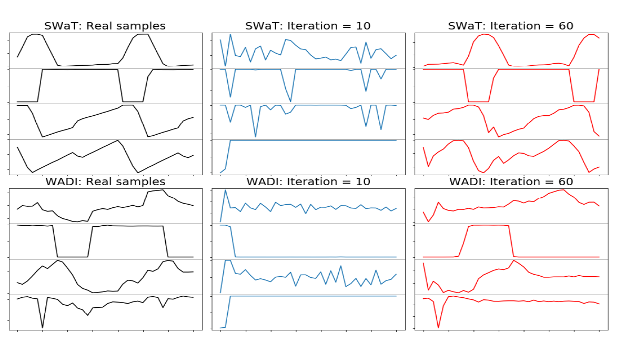
Results I – Generating samples
Notes:
Here we see a comparison between generated samples at different traning stages:
GAN-generated samples at early stage are quite random while those generated at later stages took the distribution of the original samples.
Note that the plot only shows four variables for each dataset as visualization examples.

Slide 9
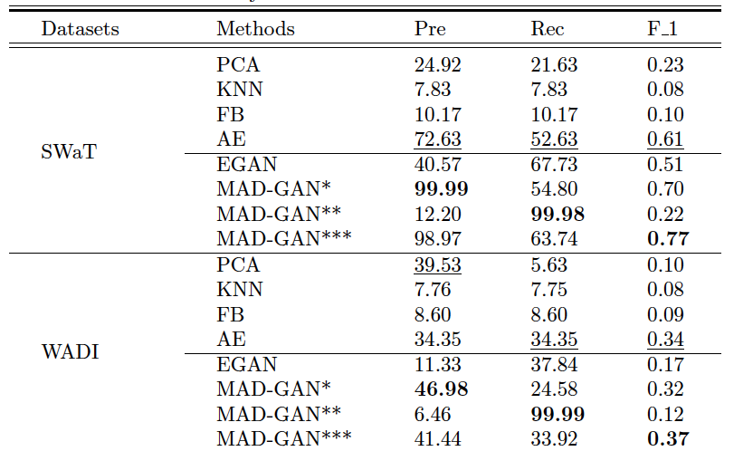
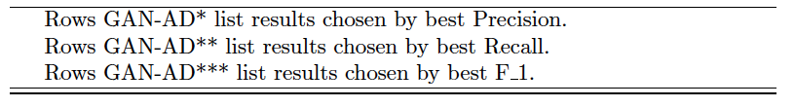
Results II – Anomaly detection
Notes:
They have evaluated the anomaly detection performance of MAD-GAN on the two datasets. To reduce the computational load, they reduced the original dimension by PCA.
For comparison on the anomaly detection, they also did experiments with PCA, K-Nearest Neighbors, Feature Bagging and Auto-Encoder.
To compare with another GAN-based method they also added Efficient GAN, noted EGAN in the table, whose discriminator and generator are fully connected neural networks.
For the SWaT dataset, if we look at the MAD-GAN model with the highest F1 score, it outperforms the other popular methods for both precision and recall.
For the WADI dataset, also focused on model with highest F1 score, recall is slightly lower than the Auto-Encoder.
However for the best recall model, MAD-GAN outperformed the others.
Although the presision seems poor, it can achieve a near 100% recall value.
This would be acceptable in the cyber-attack setting as the cost for false positives are tolerable for detecting all the instrusions.
In comparison, none of the popular detection methods can achieve a recall near this.

Slide 10
Conclusion
Explored the use of GANs for CPSs
Outperformed other methods
Novel Discrimination and Reconstruction Anomaly Score
Early attempt on this problem using GANs
Notes:
The paper explored the use of GANs for cyber-physical systems, that generates lots of multivariate data.
Their proposed method outperforms other unsupervised detection methods, for the two datasets on the CPS intrusion use case.
They propose a novel discrimination and reconstruction anomaly score.
This is, as they say themselves, an early attempt on multivariate anomaly detection, and we will probably see further investigations down the line.
Thanks.

